Slide 1
Building Cross-Platform Machine Learning Models using ML.NET and ONNX
NOT YOUR GRANDMA’S MACHINE LEARNING MASTERCLASS

Slide 2

History:
Electronics Engineer
Worked for TIA at CSIR
Gunshot Recognition with SAPS
Worked for LarcAI as RPA Engineer
Email classification at Hollard, MiWay, LegalWise
Spoke at AI Africa and other
Co-presented with UIPath heads
Worked for Cognadev as a Senior Software Developer
Built NLP cognition classifier
Currently working for IQBusiness as Senior Primary Consultant
WHO THE * AM I?
Notes:
What makes me a good coder is not that I give coding lessons to my uncle Bob on Fridays or that linters and Sonar analyzers sit idle on my computer

Slide 3
IN THIS EPISODE:
Create an image classifier
Learn what that means
Learn how to work with Model Builder
Learn how to use the model directly
Learn how to work with the ML.NET pipeline
Learn how to package the model as ONNX
Learn what that means
See how we can import the model in other projects
Learn what else there is to use out there
Learn what the limits of ML are

Slide 4
MACHINE LEARNING OVERVIEW
Extracts (trains) a function from a dataset (broken down into features)
Classification is extracting a discreet level with confidence and allocating it a label
Regression is extracting just the continuous level and adjusting it to the expected output
Common use cases include sentiment analysis, product recommendation, price prediction, customer segmentation, object detection, fraud detection, sales spike detection, image classification, sales forecasting and much, much more
Algorithms determine the extracted function as well as its limitations
Some algorithms are better than others in certain applications
Parameter tuning is how we optimize the algorithm to give the best performance
It all comes down to good data
Garbage in – garbage out

Slide 5
ML.NET OVERVIEW
Free, open-source and cross-platform ML framework
Built for .NET developers
Integrates with existing tools and devops
Extended with Tensorflow and more
Trusted, private and proven (used by Microsoft in production for years)
High performance and accuracy (better than scikit-learn and H20)
Can run on-prem, in Azure or anywhere in the cloud
https://dotnet.microsoft.com/apps/machinelearning-ai/ml-dotnet

Slide 6
SETUP:
Install .NET Core https://dotnet.microsoft.com/download/dotnet/5.0
Install ML.NET install: dotnet tool install -g mlnet update: dotnet tool update -g mlnet
Install Model Builder https://aka.ms/mlnettemplates
Test that dotnet and mlnet are added to environment path

Slide 7
1. Image Classification
Here we will learn how to:
Get some sweet data
Work with MLNET CLI
Create a new ML project
Train an image classifier
Predict the label of an image
Update CV as “AI Specialist”
Let’s rock and roll!

Slide 8

Notes:
Kaggle has everything that a data scientist would ever need
Data
Notebooks
Courses
Notebooks on data
Rock Paper Scissors Dataset Order by only datasets
Look at data
CMD into folder
mlnet -h mlnet image-classification -h mlnet image-classification --dataset “archive/rps-cv-images” YOURS MAY HAVE TO DOWNLOAD RESNET Look into after process folder solution Run program Try photo of own hand

Slide 9
ANN, RNN, DNN and CNN
Ingredients to bake your own Neural Network: • Neurons
• Synapses
• Weights
• Biases and Activation
Artificial Neural Networks are like neurons in the brain.
Recurrent Neural Networks are ANN’s where the previous neuron’s output can be used as the input for the next
Deep Neural Networks are RNN’s with multiple layers.
Convolutional Neural Networks are DNN’s that assign weight to each neuron and adjusts according to bias
x1
w1
w3
x2
w2
x1
w1
w3
x2
w2
b

Slide 10

$$f\left({b+\sum_{i=1}^{n}{x_{i}w_{i}}}_{n}\right)$$
Notes:
Giving us this sexy little transfer function right here (simplifications do apply, batteries not included)

Slide 11
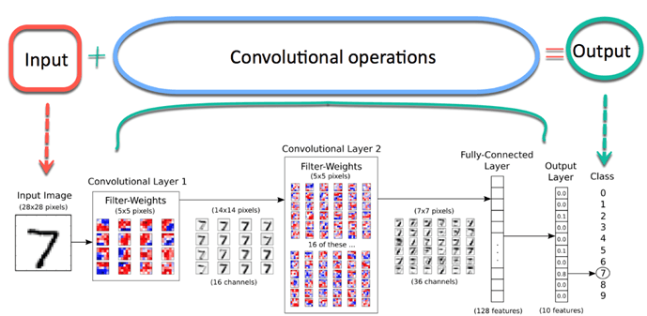
Notes:
Giving us this sexy little transfer function right here (simplifications do apply, batteries not included)

Slide 12


Slide 13

Notes:
Look at SLN
Show the model
Show the console app
Show the downloaded image

Slide 14
1. Sarcasm Detection
Here we will learn how to:
Get some more sweet data
Work with MLNET Model Builder
Import the model into an existing application
Let’s rock and roll!

Slide 15
Blazor Overview
Build interactive websites with C# instead of JS
Can compile C# into WebAssembly, allowing you to run anything in the browser
Razor pages on Steroids
SignalR for instant feedback
https://dotnet.microsoft.com/apps/aspnet/web-apps/blazor
https://awesomeopensource.com/project/AdrienTorris/awesome-blazor

Slide 16

Notes:
Kaggle has everything that a data scientist would ever need
Data
Notebooks
Courses
Notebooks on data
Rock Paper Scissors Dataset Order by only datasets
Look at data
CMD into folder
mlnet -h mlnet image-classification -h mlnet image-classification --dataset “archive/rps-cv-images” YOURS MAY HAVE TO DOWNLOAD RESNET Look into after process folder solution Run program Try photo of own hand

Slide 17
1. YOLO
Here we will learn:
What ONNX is
What YOLO is
How YOLO can be built into a C# application using ONNX
Let’s rock and roll!

Slide 18
ONNX Overwiew
Open format built to represent machine learning models
Grants ability to use the same models with multiple frameworks
Abstracts the model away from implementation
Makes it easier to access hardware optimizations
https://onnx.ai/
https://github.com/onnx/models

Slide 19
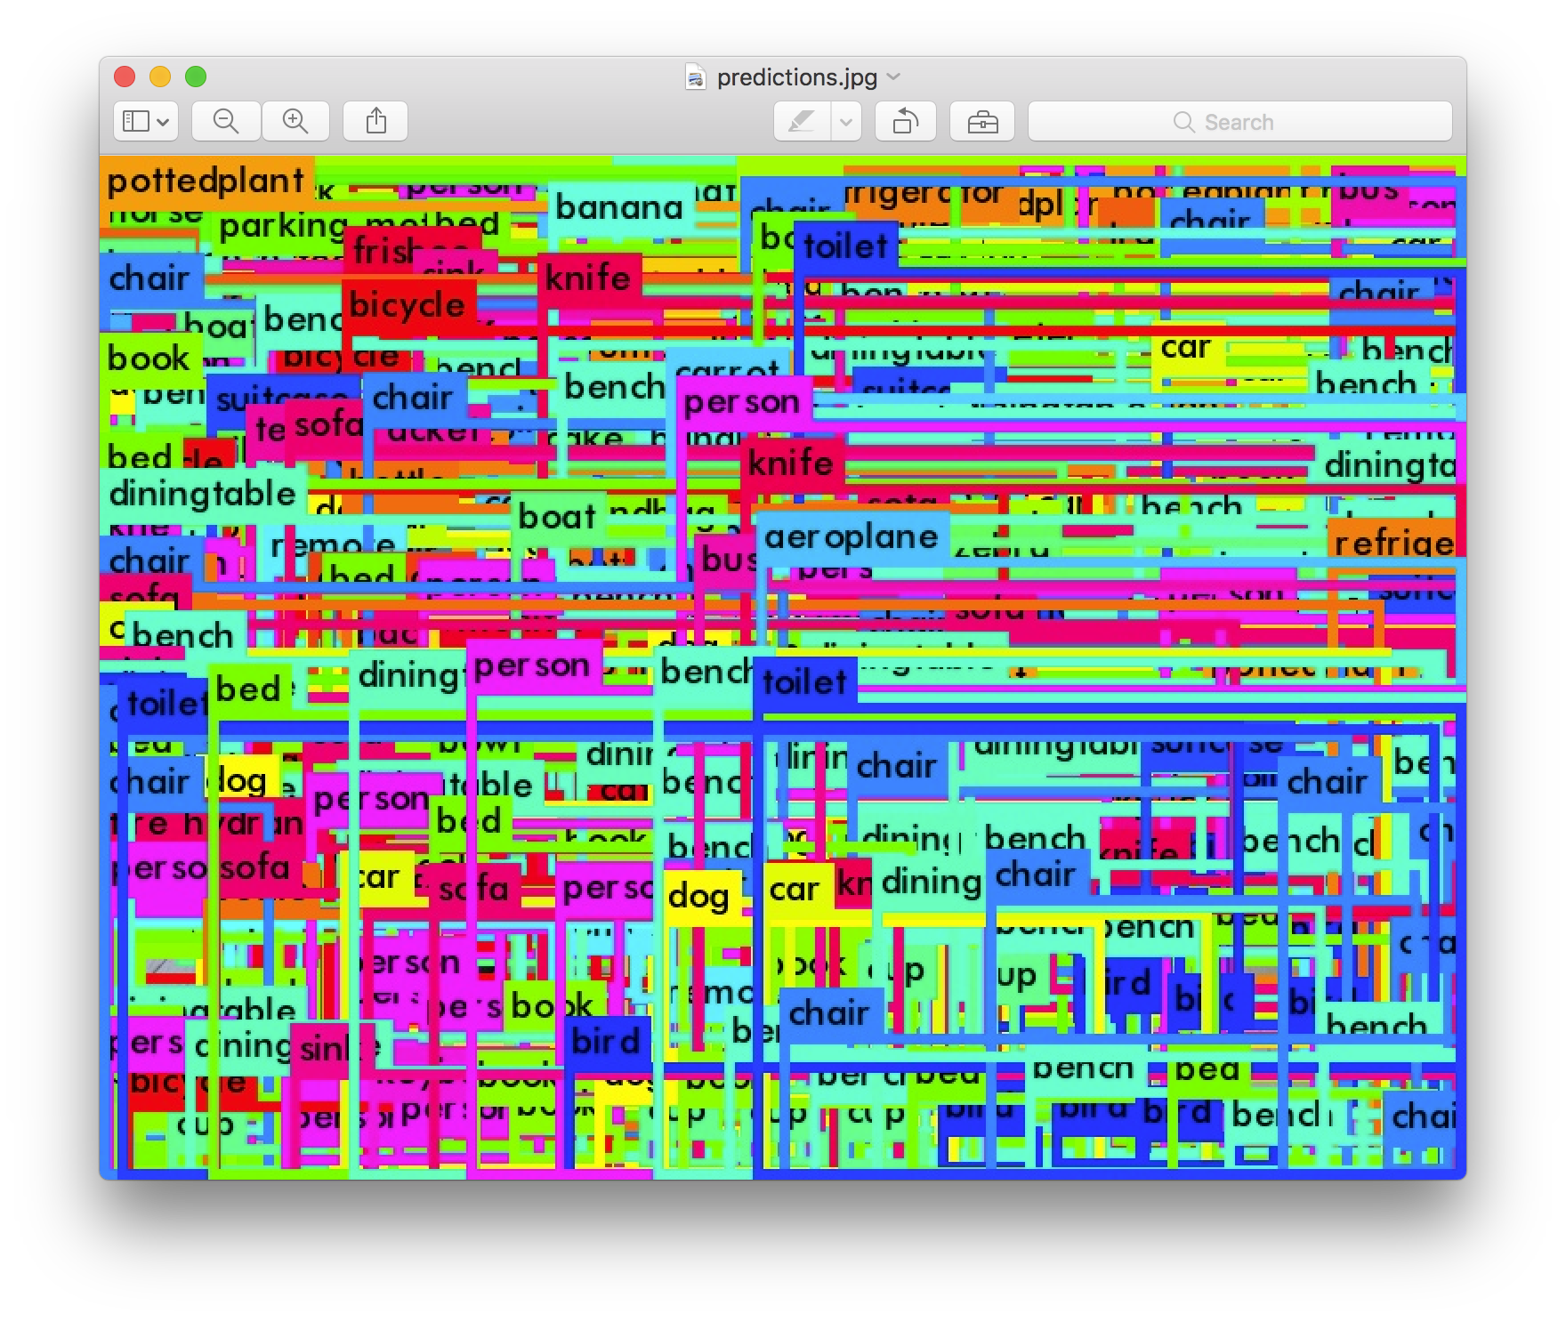
YOLO!!!

Slide 20
YOLO!!!

Slide 21
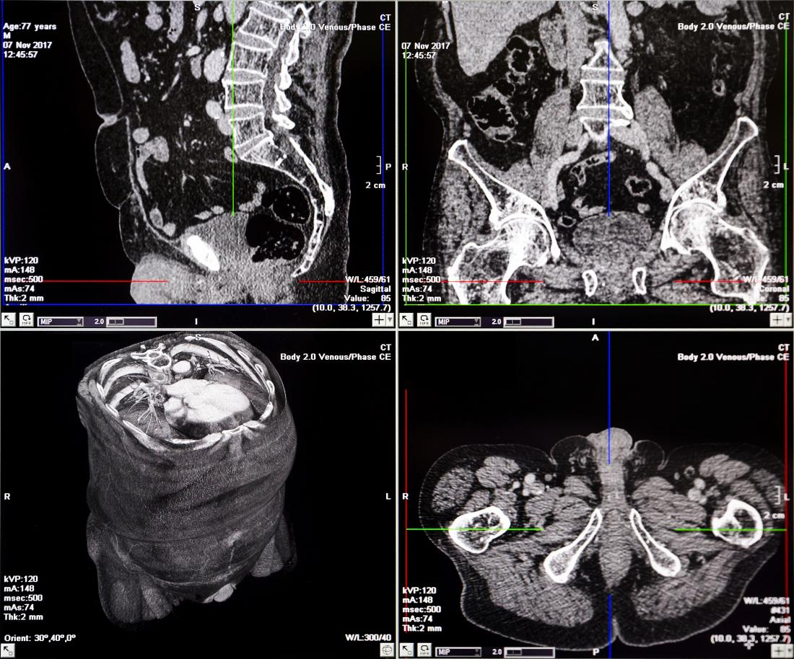
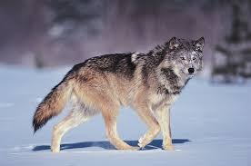
WARNING

Slide 22
Conclusion
Machine Learning is cool
You should see where you can use it
Just be careful do

